Slide 1
PASS Seminar Business case for sustainability:
CLP’s experience
Kit-fong Law
Manager – Group Sustainability
1 April 2019

Slide 2
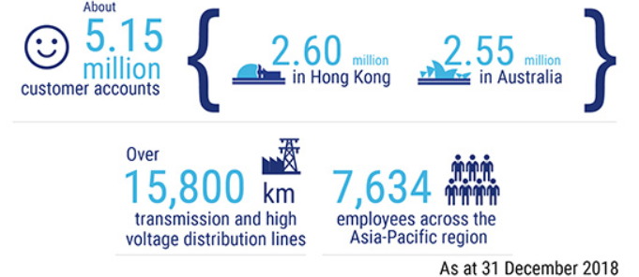
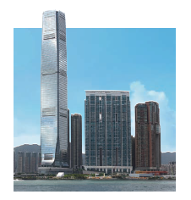
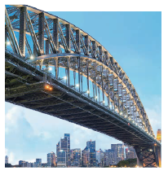
About CLP
5 major markets
Hong Kong
Mainland China
India
Southeast Asia & Taiwan
Australia

Slide 3
CLP has been producing a Sustainability Report since 2002
…but sustainability reporting is NOT sustainability

Slide 4
But the report helps us respond to a changing business landscape
Reporting frameworks and regulations are tightening – more stringent frameworks (e.g. GRI) and policies & regulations on ESG disclosures (e.g. HKEx)
Increasing environmental & social awareness – more public expectations and scrutiny; compliance is not enough
Increasing expectations on data quantity & quality – more data points and independent verification expected for credibility
Information is available and spread at unprecedented speed – a public report helps defend the Company’s position rapidly

Slide 5
…by driving performance and engaging stakeholders
Stakeholder Engagement
Drive Performance
Provides context on our operating environment; being transparent about challenges and avoid reputation risks
Creates opportunities to align strategic direction, policies & practices, goals and management systems through the ranks and across the Group
Build awareness, knowledge and informed views to support development of sound polices and regulations
Making a public commitment; public increases pressure to deliver

Slide 6
Investors are increasingly interested in ESG
What is the market/industry outlook?
What are the company’s ESG risks? And their potential impact?
Is the Company managing these risks well?
How can the reported metrics help my decision-making?

Slide 7
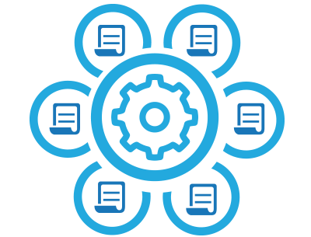
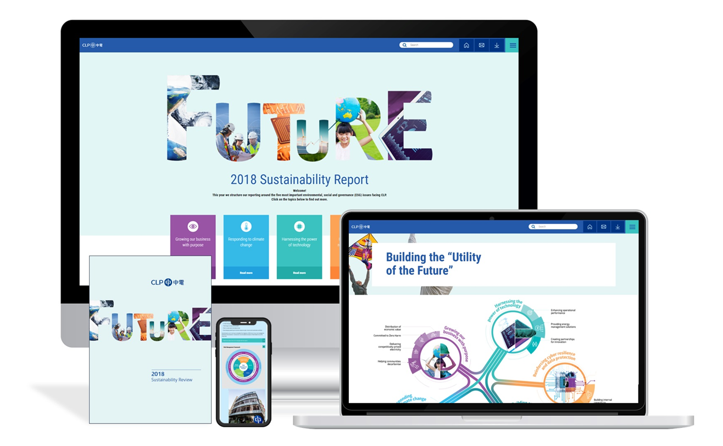
We consider the needs of investors when preparing the Report
Materiality assessment
Stakeholder interests
Data Collection
Robustness
Internal control
Guidance
Standardisation
Compliance & Reporting frameworks
Data Assurance
Completeness
Reliability
Sustainability Report

Slide 8
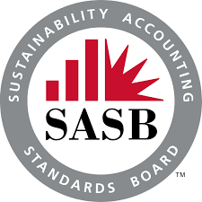
ESG reporting frameworks have been evolving
…but are they fit-for-purpose?
Notes:
GRI – comprehensive disclosure
SASB – some alignment within industry
IR – embedding sus into business; how values are being created

Slide 9
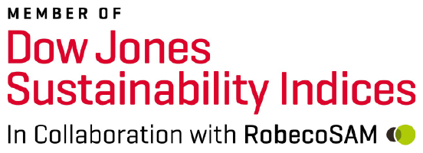
Investors/analysts continue to develop their own assessments
Notes:
Disclosure are not mandatory in most cases – or mandatory disclosure are very limited: analysts don’t have sufficient information
Different methodologies
Aspects covered and weighting
Focus on management approach vs performance
Emphasis on disclosure (e.g. CDP in its early days) – and quantitative disclosure (Bloomberg)
Public information vs internal document

Slide 10
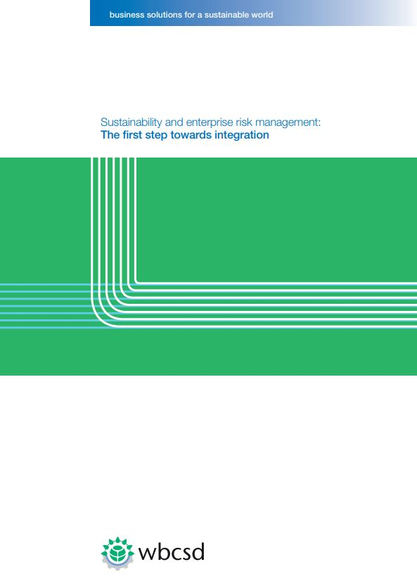
Are we communicating ESG risks well?
29% alignment between material risks disclosed in a company’s risk filings compared to material issues in sustainability report
35% of companies had no alignment
Challenges:
ESG risks tend to be long-term and difficult to quantify in monetary terms
Lack of understanding of ESG risks at the board level
ESG risks are often viewed as less significant than operational or financial risks
Source: WBCSD (Jan 2017), Sustainability and enterprise risk management: The first step towards integration.
Notes:
In the KPMG/HKICS Survey Report 70%of respondents thought that ESG was a good idea, but only 30 are actually implementing it. Why the gap?
Going beyond operational targets, is our alignment with the current trend amongst investors to integrate ESG performance into decision making.
We see this as fundamental from a risk management perspectives, for all the reasons – and more – that I just mentioned.
But what to include in ESG reporting is critical to make it meaningful. ESG is not intended to specify social responsibility, or about “doing good”. Instead ESG is intended to be a risk management tool, both for investors and for corporates who ultimately have to manage these risks at an operational level. Looking at the current status of material risks being disclosed by issuers, there is a lack of alignment between what’s included in the sustainability report and what is disclosed in risk filings to the stock exchange. Only 29% of material issues disclosed in sustainability reporting are also reported as risks in mainstream reporting. 35% of companies are strictly speaking misaligned, based on a WBCSD report in 2017. (FYI - https://www.wbcsd.org/Programs/Redefining-Value/Business-Decision-Making/Measurement-Valuation/Resources/Sustainability-and-enterprise-risk-management-The-first-step-towards-integration)
That means that ESG reporting has not achieved its purpose, namely to provide the tools to look beyond short term business risks, but instead understand how the business may need to evolve to deal with changing social and environmental circumstances in the medium to long term. This requires some level of understanding on what these risks mean from a financial perspective, so that the board can use this information for decision making. This is ultimately what makes ESG real at an operational level. COSO and WBCSD published a report on how to integrate ESG into Enterprise Risk Management, something I would encourage all issuers to review if they haven’t already done so.

Slide 11
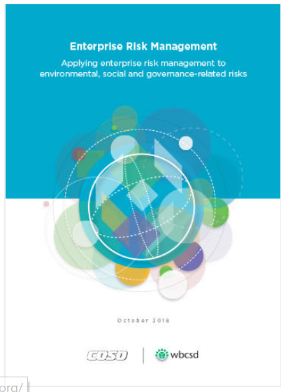
ESG materiality is essential to better understand where the headwinds are coming from
Forward looking – clarify ESG risks and opportunities ahead
A more focused ESG report, and increases strategic value of a sustainability report
Starting Point
Megatrends analysis to deepen understanding of how broad changes in the environment, society, technology and governance affects the company
Source: COSO/ WBCSD (Oct 2018), Guidance for Applying Enterprise Risk Management (ERM) to Environmental, Social and Governance (ESG)-related Risks
Notes:
Beyond risk management, materiality of ESG reporting also helps to manage stakeholder expectations, responds to reporting requirements including HKEx, and allows for improved communication in a focused sustainability or ESG report.
We have conducted a megatrends analysis this year to look at the big picture of what CLP is facing in the various markets where we operate. This is the basis for a more detailed analysis of existing risk management and other internal tools, that we discussed in detail with the senior management team across the various business units and group functions at CLP. This helped us to confirm what is material for reporting in our sustainability report. We look forward to disclosing more details on this in our upcoming 2018 report.

Slide 12
CLP’s 2018 SR focuses on five material topics

Slide 13
New frameworks have been developed for climate change – e.g. CDP, TCFD

Slide 14
ESG reporting will stay – what’s next?
Climate change gets the most attention
What’s the next big topics? Water? Plastic? SDGs? Impact measurement?
ESG reporting is mainstreaming
Integration with the Annual Report? Or remains as a standalone document?
Assurance becomes a prerequisite
Limited vs reasonable
Assurance for other green financing tools
Demand for ESG information is on the rise
More ESG surveys?
Harmonisation of different frameworks?
Increase reporting frequency?
Valuing / quantifying ESG risks?

Slide 15
PASS Seminar Business case for sustainability:
CLP’s experience
Kit-fong Law
Manager – Group Sustainability
1 April 2019

